Slide 1
STATE COUNCIL OF EDUCATIONAL RESEARCH AND TRAINING, CHENNAI – 06
STATE LEVEL TRAINING FOR
DISCTRICT RESOURCE GROUP
XII Std. Biology-Botany & Botany

Slide 2
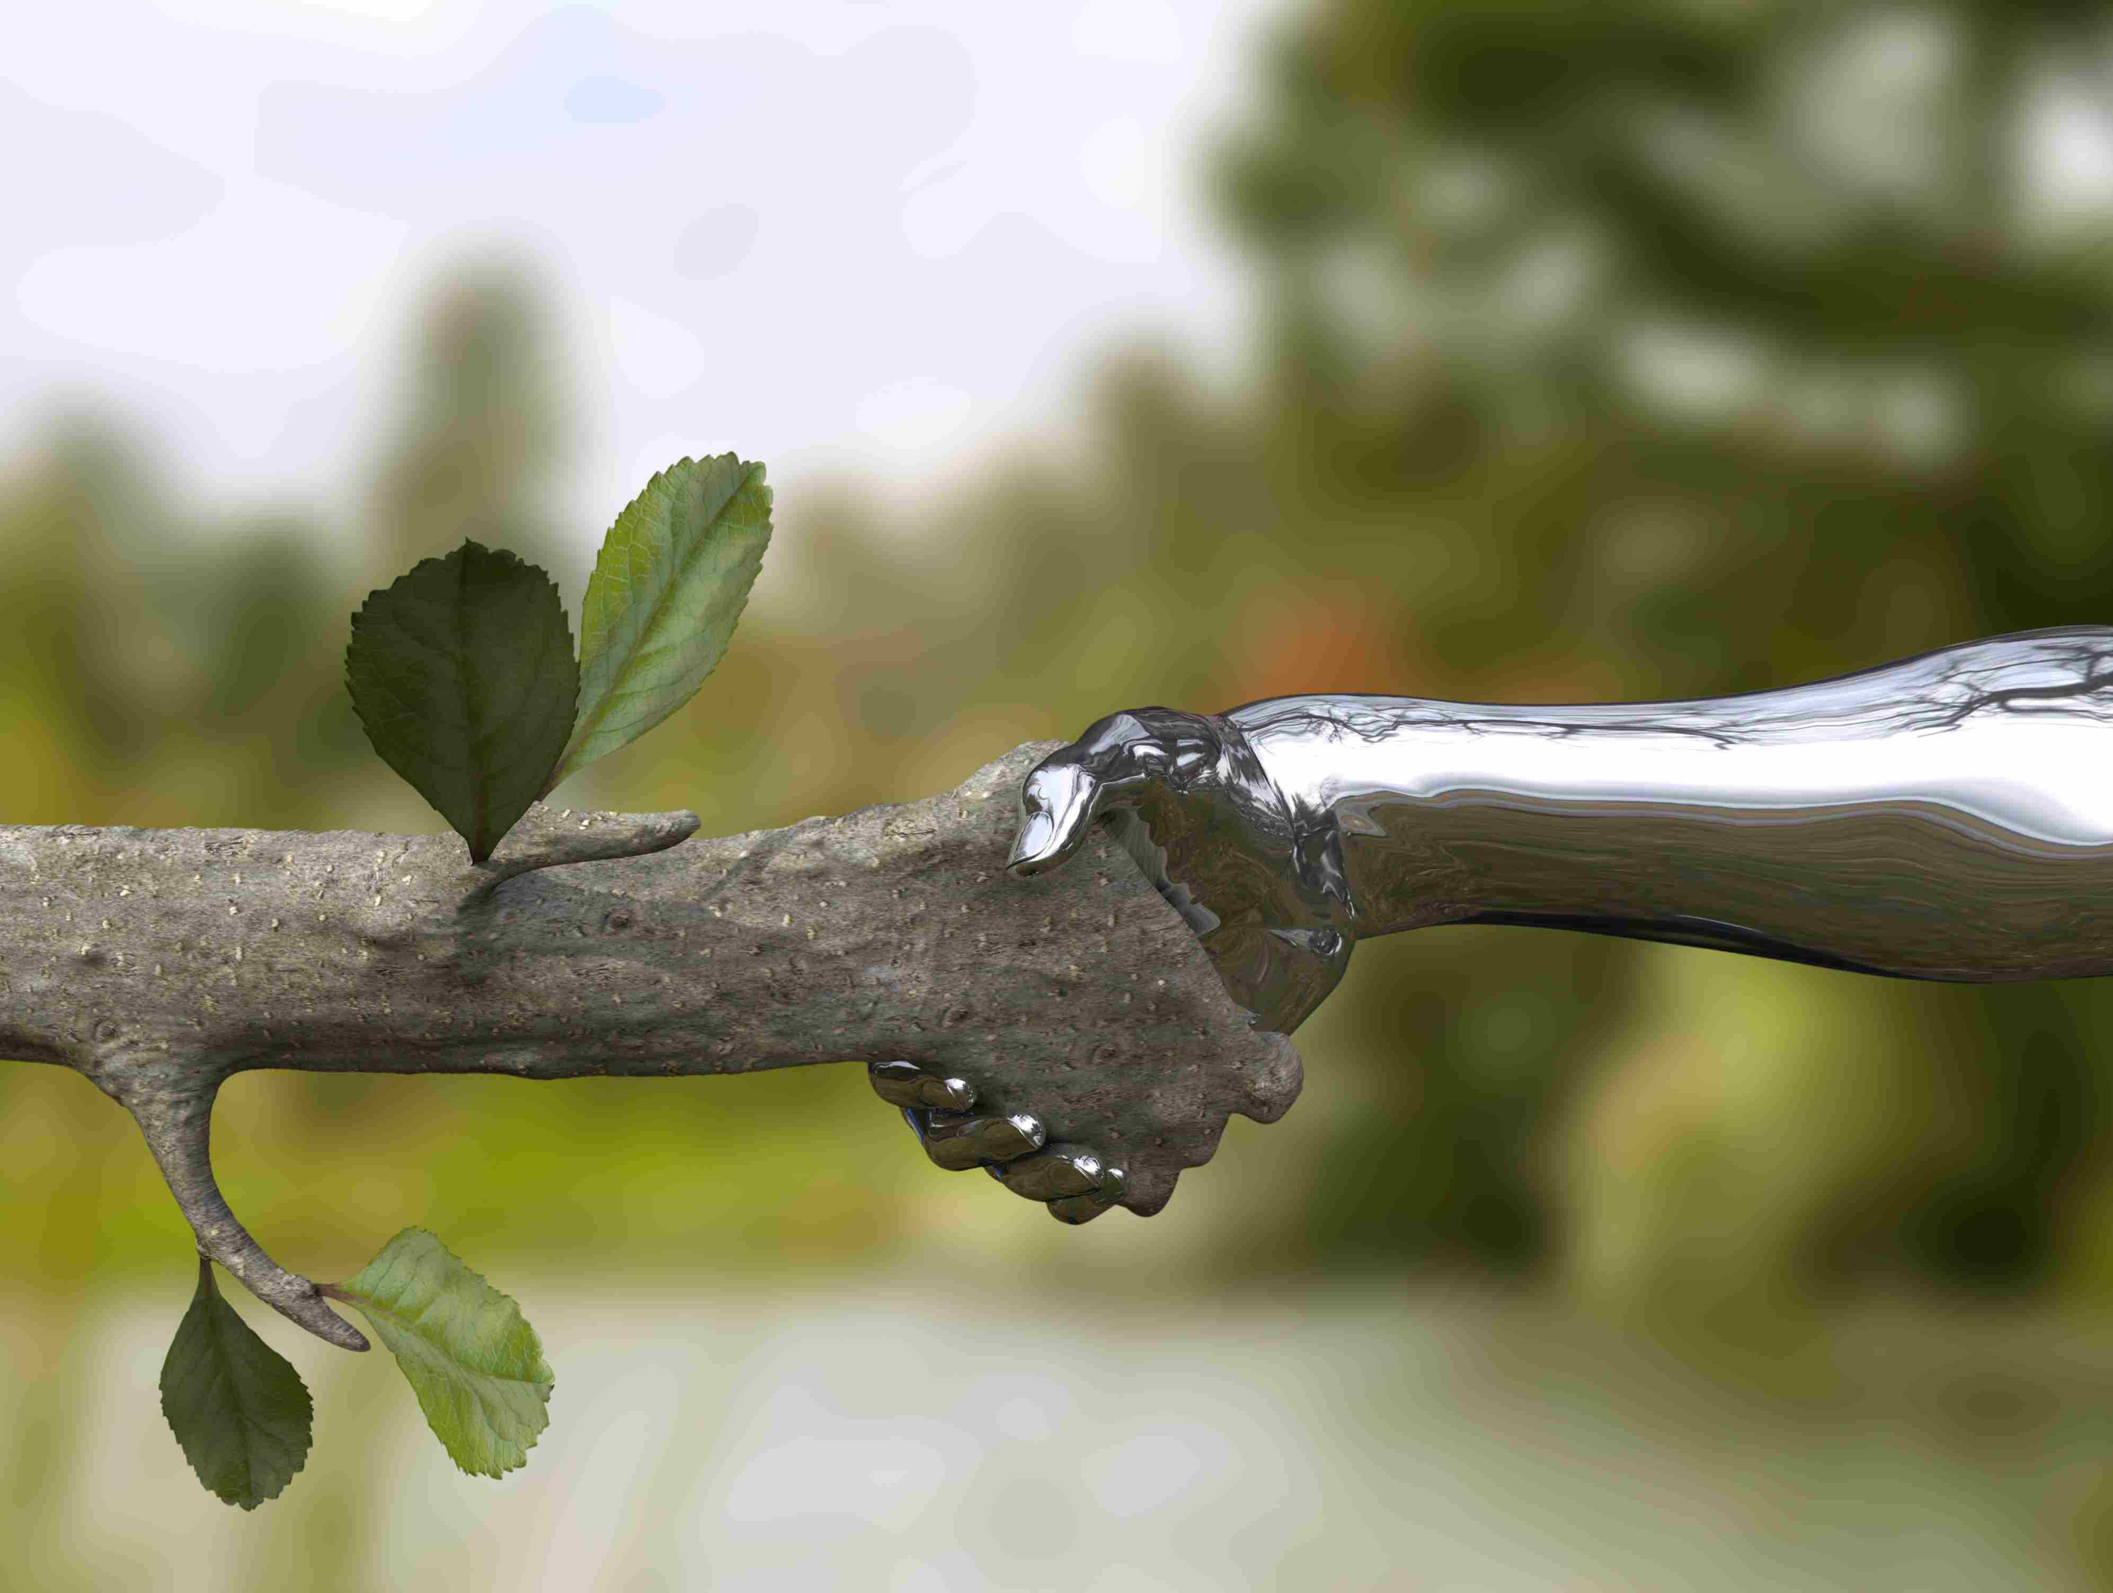
பாடம் 7
சூழல்மண்டலம்

Slide 3
Chapter 7
ECOSYSTEM

Slide 4
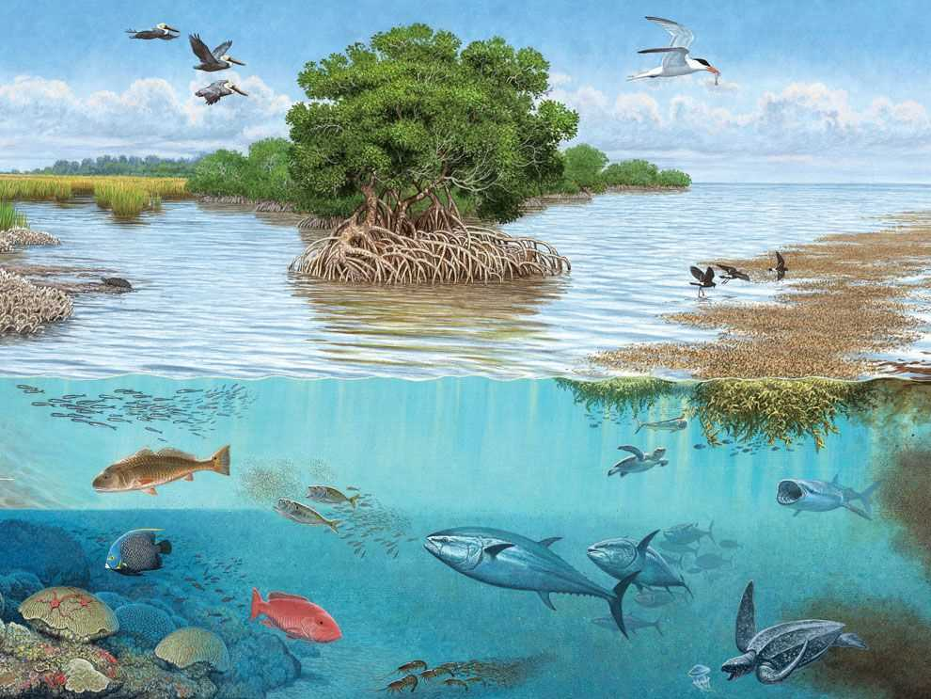
Learning objectives
The learner will be able to,
Describe the Structure, functions and types of ecosystems
Draw ecological pyramids by means of number, biomass and energy
Interpret carbon and phosphorus cycle
Recognise pond ecosystem as a self-sufficient and self-regulating system
Analyse ecosystem services and its management
Discuss about the importance and conservation of ecosystem
Explain causes, process and types of succession
Classify vegetation types of India and Tamil Nadu

Slide 5
NEW BOOK Vs OLD BOOK
S.No | Features | New book | Old book
1. | No. of pages | 28 | 15
2. | No. of diagrams | 33 | 07
3. | No. of Do You know Box | 09 | No
4. | No. of activity box | 02 | No
5. | No. of tables ( differences) | 01 | No
7. | No. of flowcharts | 06 | No
8. | Additional information box | 03 | No

Slide 6
Chapter outline
7.1 Ecosystem
7.2 Function of ecosystem
7.3 Succession
7.4 Vegetation

Slide 7
Introduction
The term ‘ecosystem’ was proposed by
A.G. Tansley (1935)-
‘system resulting from the integration of all the living and nonliving factors of the environment’.
Odum (1962)-
ecosystem ‘as the structural and
functional unit of ecology’.
Parallel terms for ecosystem Biocoenosis – Karl Mobius Microcosm – S.A. Forbes Geobiocoenosis – V. V. Dokuchaev, G.F. Morozov Holocoen – Friederichs Biosystem – Thienemann Bioenert body – Vernadsky

Slide 8
7.1 Structure of ecosystem
Biotic ( living ) components
Abiotic (non-living) components
Biotic (living) components
Abiotic (non-living) components
Climatic factors (Air, water, sunlight, rainfall, temperature and humidity).
Climatic factors (Air, water, sunlight, rainfall, temperature and humidity).
Autotrophic components
Heterotrophic components
Edaphic factors
(soil air, soil water and PH of soil).
Edaphic factors
(soil air, soil water and PH of soil).
Plants - producers.
consumers
Topography (latitude, altitude ).
Topography (latitude, altitude ).
Macroconsumers
Herbivores, carnivores and omnivores
Organic components ( carbohydrates, proteins, lipids and humic substances).
Organic components ( carbohydrates, proteins, lipids and humic substances).
Microconsumers -Decomposer:
Bacteria, Actinomycetes and Fungi.
Inorganic substances (C, H, O, N and P ).
Microconsumers -Decomposer:
Bacteria, Actinomycetes and Fungi.
Inorganic substances (C, H, O, N and P ).

Slide 9
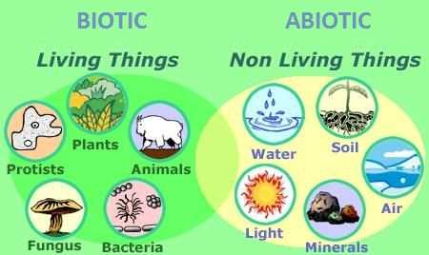
Structure of ecosystem

Slide 10
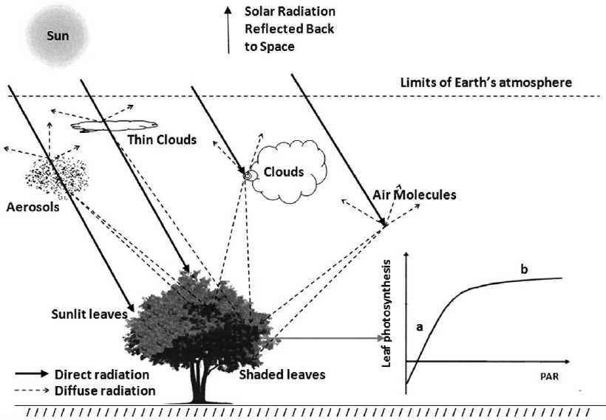
7.2 Functions of ecosystem
7.2.1 Photosynthetically Active Radiation – (PAR)
400 – 700 nm
34 percent that reaches the earth is reflected back in the atmosphere.
While 10% is held by ozone, water vapours and atmospheric gases.
Out of this 56%, only 2 – 10% of the solar energy is used by green plants.
Photo voltic detectors ( 0-3000)

Slide 11
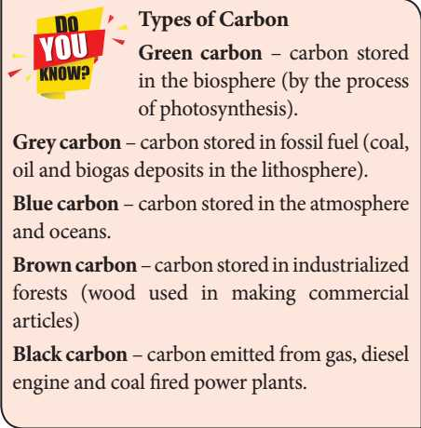
7.2 Functions of ecosystem

Slide 12
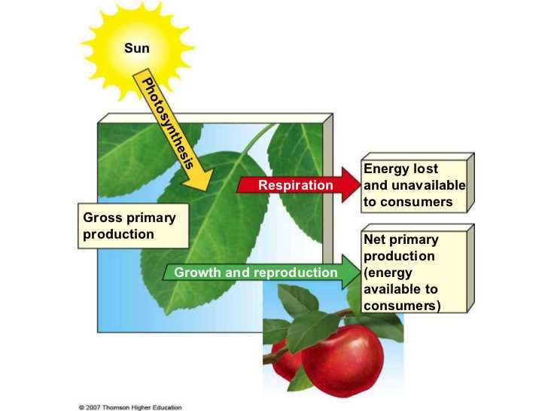
7.2.2 PRODUCTIVITY OF ECOSYSTEM
The rate of biomass production per unit area in a unite time is called productivity.
1.Primary productivity
(Energy stored in autotrophs )
a. Gross primary productivity
GPP= TOTAL ENERGY ( Photosynthesis)
b. Net primary productivity
NPP = GPP- RESPIRATION
2.Secondary productivity.
( Energy stored in heterotrophs )
a. Gross secondary productivity
GSP= INGESTED - FAECES
b. Net secondary productivity
NSP= GSP-RESPIRATION
3. Community productivity.
( Energy stored in group of plants)

Slide 13
7.2.2 PRODUCTIVITY OF ECOSYSTEM
Factors affecting primary productivity
plant species of an area,
Photosynthetic capacity,
Availability of nutrients,
Solar radiation,
Precipitation,
Soil type,
Topographic factors (altitude, latitude, direction).

Slide 14
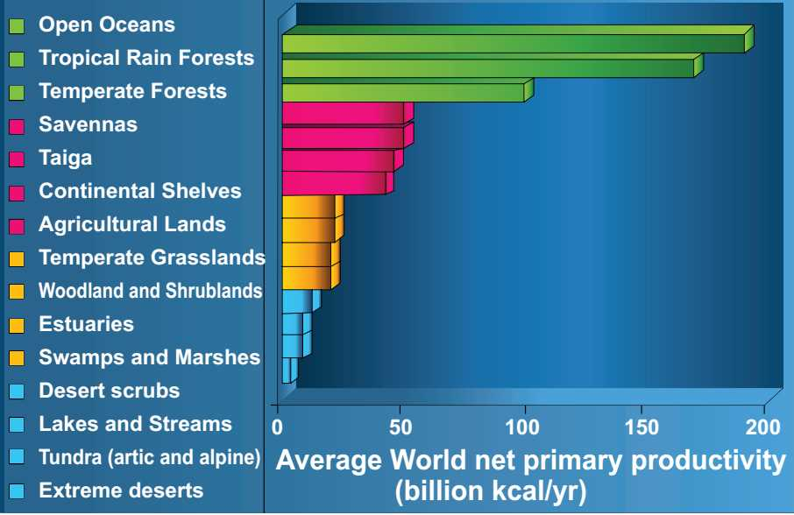
7.2.2 PRODUCTIVITY OF ECOSYSTEM
Productivity of different ecosystms

Slide 15
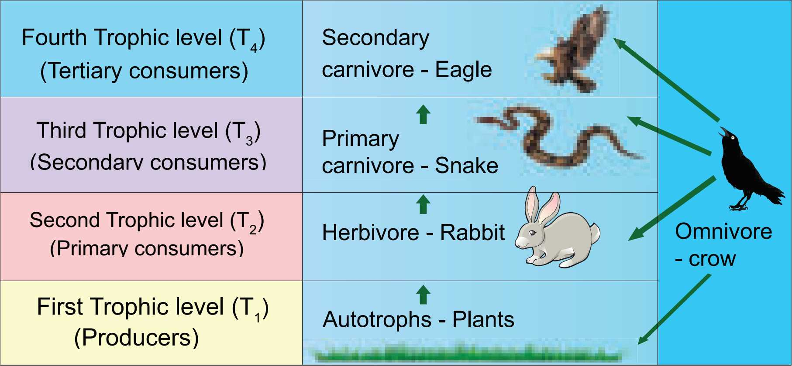
7.2.3 Concept of trophic level in an ecosystem

Slide 16
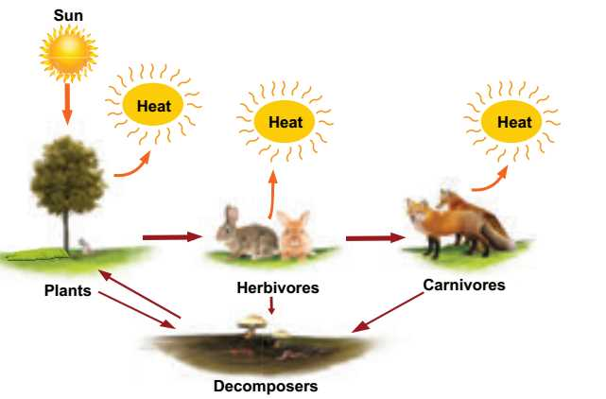
7.2.4 Energy flow
Transfer of energy in an ecosystem between trophic levels.

Slide 17
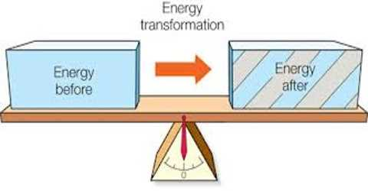
7.2.4 Energy flow
Law of thermodynamics- Storage and loss of energy.
i. First law of thermodynamics
Energy can be transmitted from one system to another in various
forms, but it cannot be destroyed or created. As a result, the quantity of energy present in the universe is constant.

Slide 18
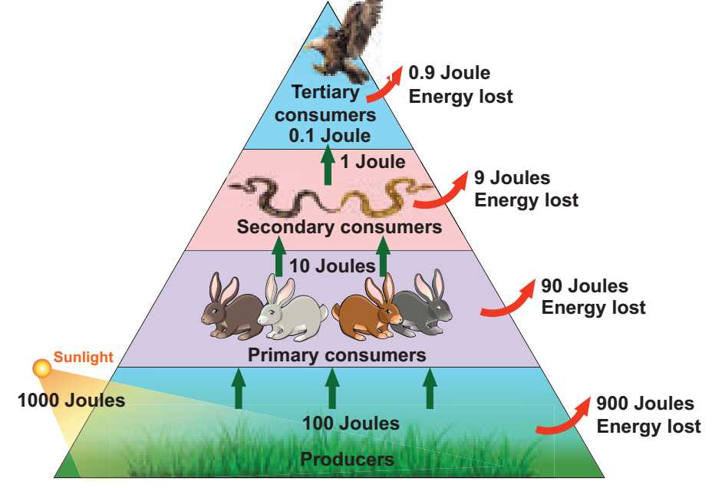
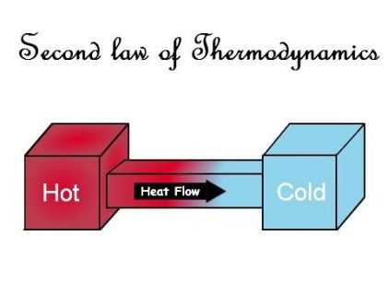
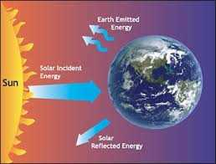
7.2.4 Energy flow
ii. Second law of thermodynamics- Energy transformation results in the reduction of the free energy of the system. Usually energy transformation cannot be 100% efficient. . Example: Ten percent law

Slide 19
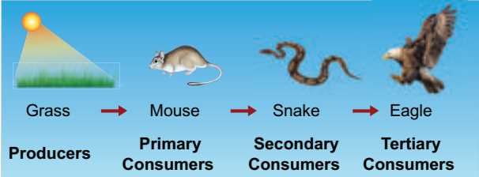
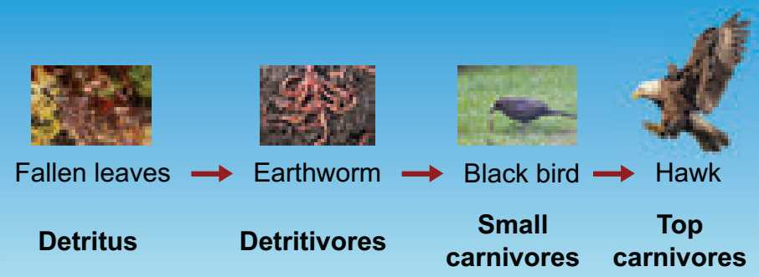
7.2.5 Food chain
Movement of energy from producers up to top carnivores.
Two types of food chain
1. Grazing food chain 2. Detritus food chain
.

Slide 20
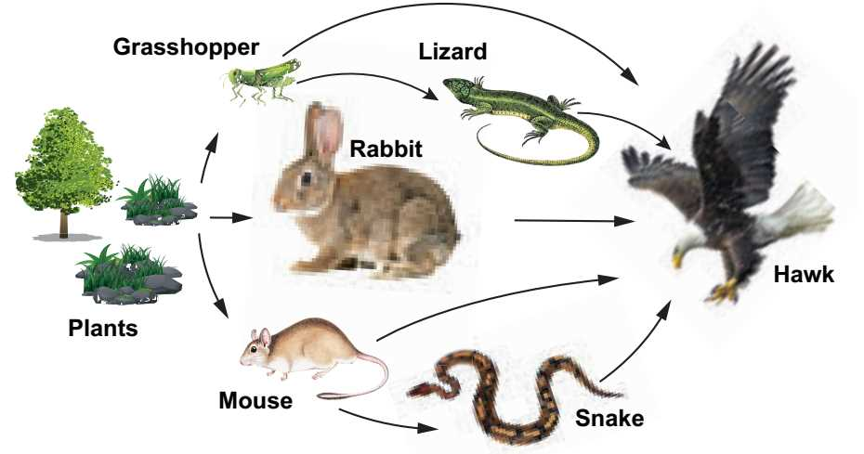
7.2.6 Food Web
Inter-locking pattern of a number of food chain.
Example: Grazing food chain.

Slide 21
7.2.6 Food Web
Significance of food web
Constructed to describe species interaction called direct interaction.
Illustrate indirect interactions among different species.
Study bottom-up or top-down control of community structure .
Reveal different patterns of energy transfer in terrestrial and aquatic ecosystems.

Slide 22
7.2.7 Ecological pyramids
A graphical representation of the trophic structure and function
at each successive trophic levels of an ecosystem.
Charles Elton (1927)- Eltonian pyramids.
Three types:
(1) Pyramids of number.
(2) Pyramids of biomass.
(3) Pyramids of energy.

Slide 23
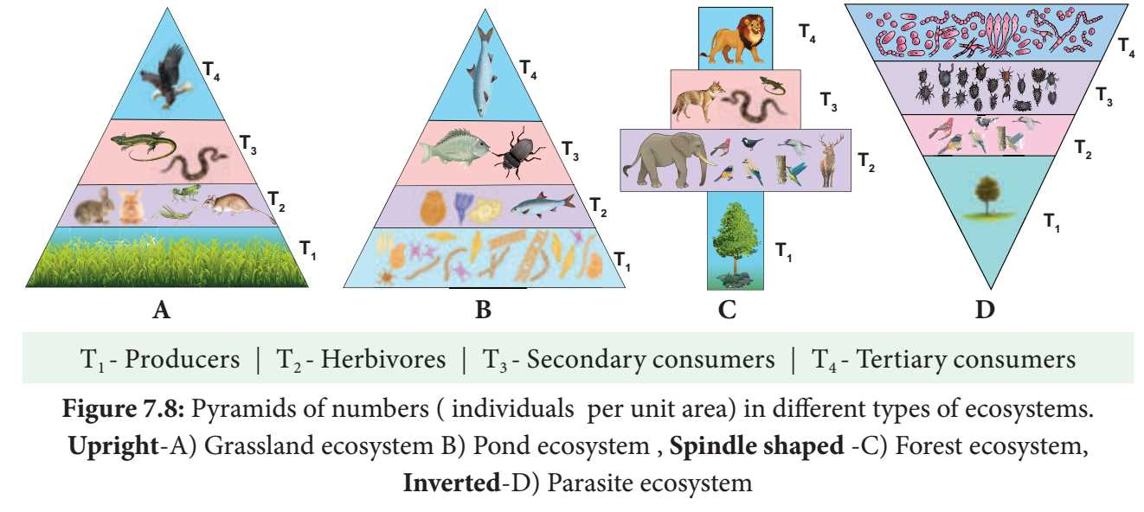
7.2.7 Ecological pyramids
(1) pyramids of number.
A graphical representation of the number of organisms present at each successive trophic level in an ecosystem.

Slide 24
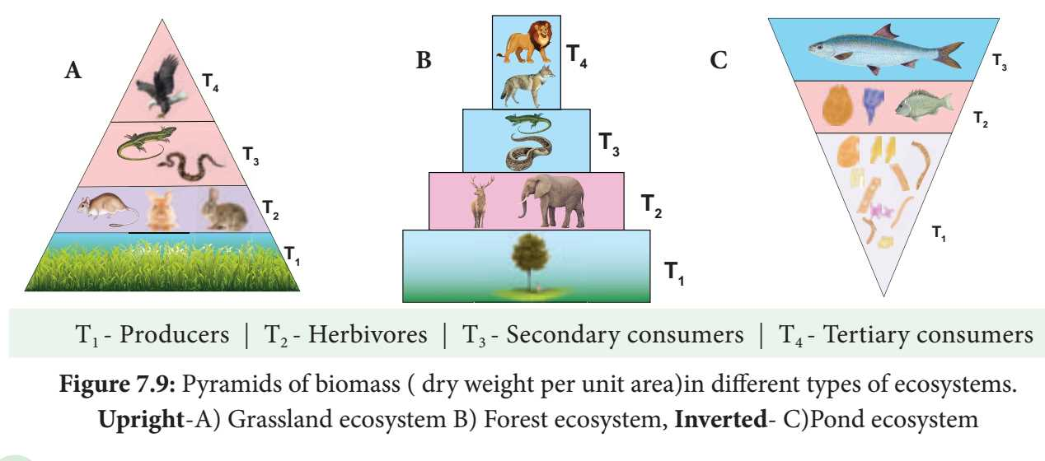
7.2.7 Ecological pyramids
(2) pyramids of biomass
A graphical representation of the amount of organic material (biomass) present at each successive trophic level in an ecosystem.

Slide 25
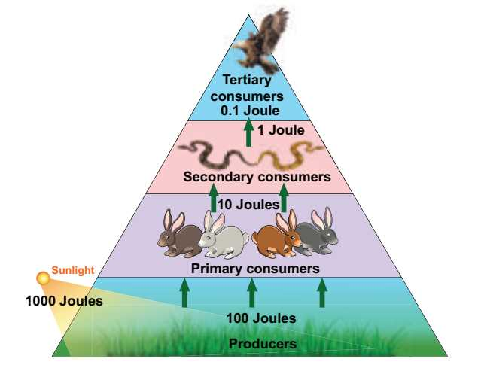
7.2.7 Ecological Pyramids
(3) Pyramids of energy
A graphical representation of energy flow at each successive trophic level in an ecosystem. Always upright.

Slide 26
7.2.8 Decomposition
Detritus (dead plants, animals and their excreta) are breakdown in to simple organic matter.
Nature of decomposition:
Carbohydrate, fat and protein are decomposed rapidly than the cellulose, lignin, chitin, hair and bone.
Mechanism of decomposition:
a) Fragmentation- Breaking down of detritus in to a smaller particles.
b) Catabolism – Breaking down of complex in to smaller ones by enzymes.
c) Leaching – Moving down the substances to lower layer of soil.
d) Humification- Formation of dark coloured humus.
e) Mineralisation- Releasing of nutrients from humus.

Slide 27
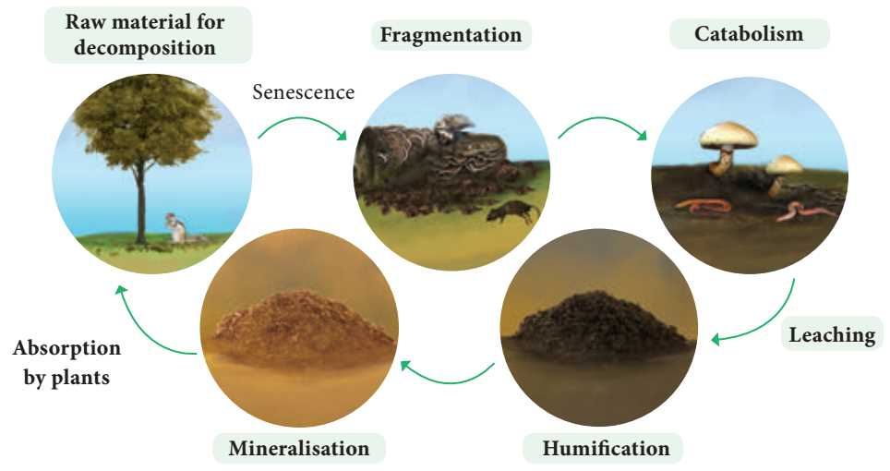
7.2.8 Process of decomposition
Factors affecting decomposition
Temperature, soil moisture, soil pH ,oxygen, chemical quality of detritus.

Slide 28
7.2.9. Biogeochemical cycle or Nutrient cycle
Exchange of nutrients between organisms and their environment.
1. Gaseous cycle – Oxygen, Carbon and Nitrogen.
2. Sedimentary cycle - Phosphorus, Sulphur and Calcium .

Slide 29
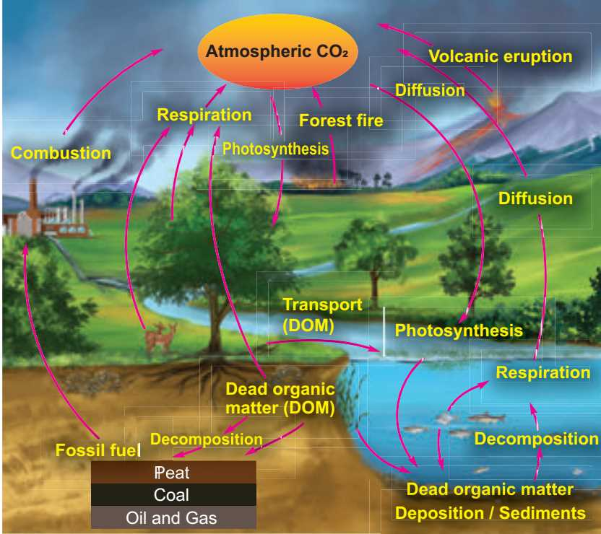
7.2.9. Biogeochemical cycle or Nutrient cycle
i) Carbon cycle : Circulation of carbon between organisms and environment .

Slide 30
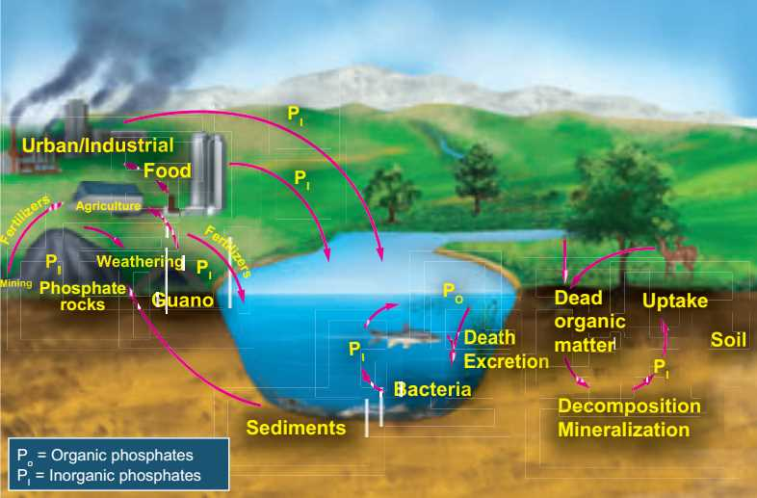
7.2.9. Biogeochemical cycle or Nutrient cycle
ii ) Phosphorus cycle : Circulation of phosphorus between organisms and environment.

Slide 31
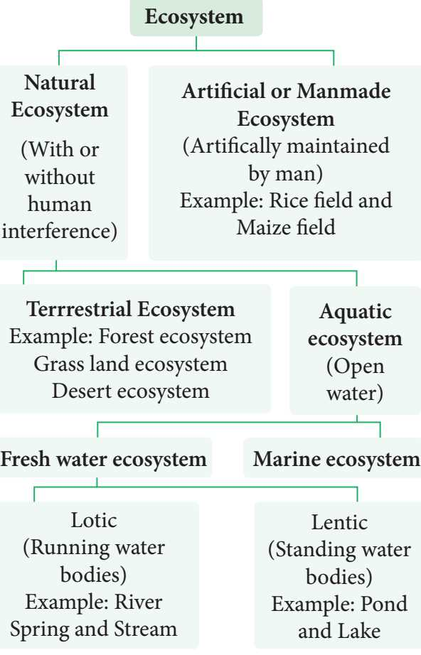
7.2.10 Types of ecosystem

Slide 32
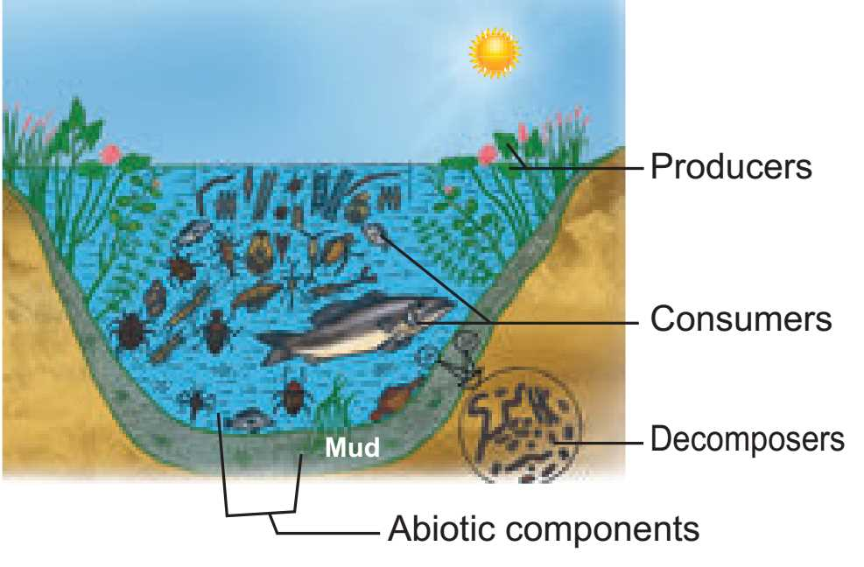
Structure of Pond ecosystem
Structure of Pond ecosystem

Slide 33
7.2.10 Pond ecosystem
Structure of Pond ecosystem
It is a self sustaining and self regulatory fresh water ecosystem.
I ) Abiotic components;
Inorgaic -CO₂, O₂,Ca, N, P. Organic -Amino acids and Humic acid.
ii) Biotic components; a).Producers
Phytoplanktons: Oscillatoria, Anabaena, Eudorina, Volvox and Diatoms.
Filamentous : Ulothrix, Spirogyra and Cladophora .
Floating plants : Azolla, Salvia, Pistia, Wolffia and Eichhornia.
Sub-merged plants : Potamogeton and Phragmitis.
Rooted floating plants : Nymphaea and Nelumbo.
Macrophytes : Typha and Ipomoea.

Slide 34
Structure of Pond ecosystem
B ) Consumers
Primary consumers : Paramecium and Daphnia.
Secondary consumers : Beetles and frogs.
Tertiary consumers : Duck , crane.
Top carnivores : Large fish, hawk ,man.
c ) Decomposers
Example: Bacteria and Fungi.
Conclusion:
Cycling of nutrients between abiotic and biotic components is
evident in the pond ecosystem, making itself self sufficient and self
regulating.

Slide 35
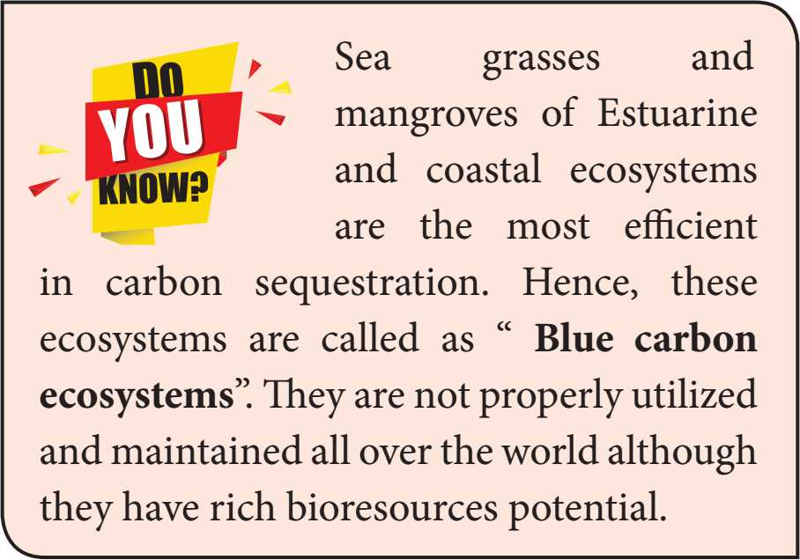
7.2.10 Types of ecosystem

Slide 36
7.2.10 Types of ecosystem

Slide 37
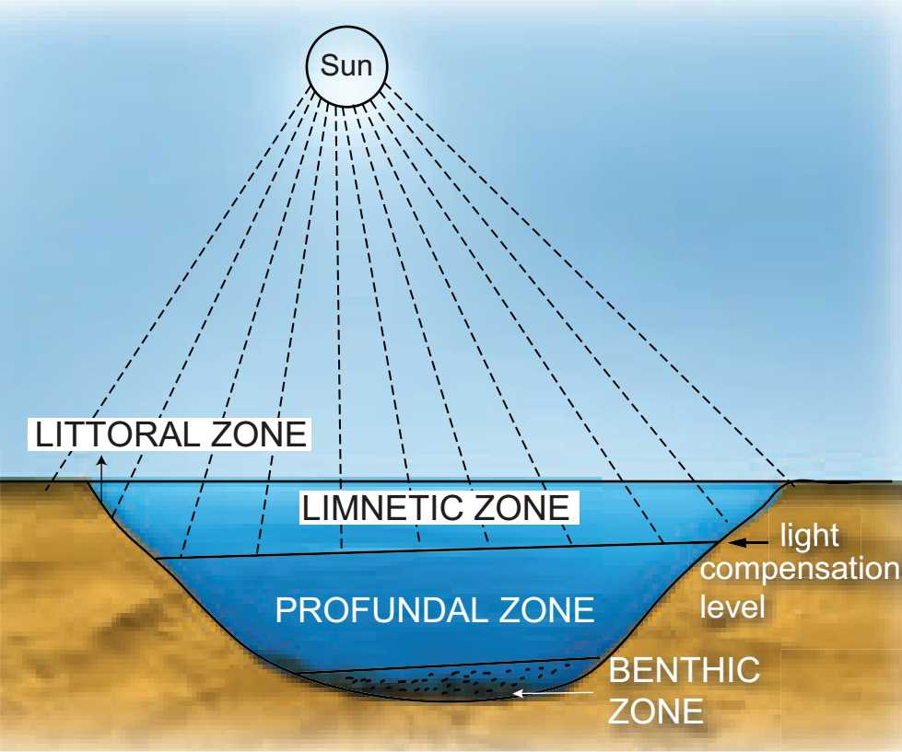
Stratification of pond ecosystem
Zones of pond
(Based on distance, penetration of light and depth)
Littoral zone – Closest to the shore.
Limnetic zone- Open water of the pond.
Profundal zone- Below the limnetic zone.
Benthic zone- Bottom of the pond.

Slide 38
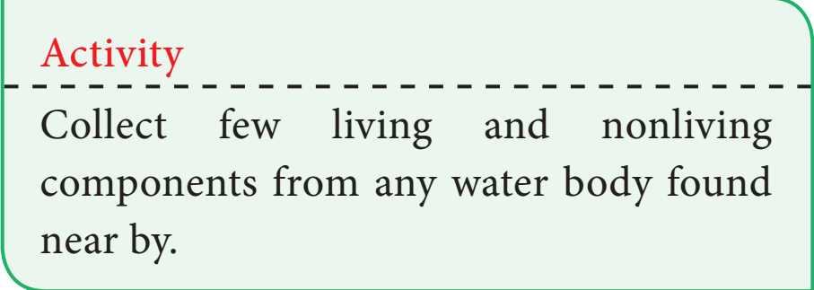
Activity

Slide 39
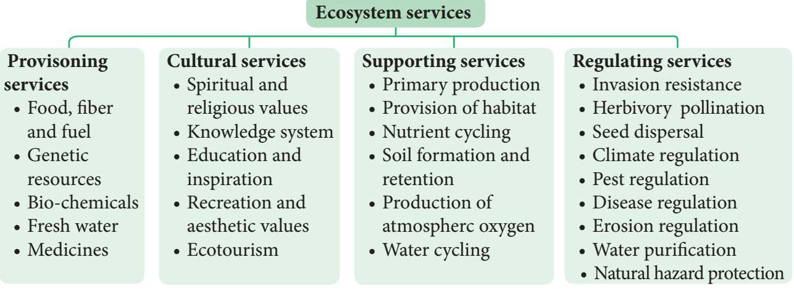
7.2.11 Ecosystem services

Slide 40
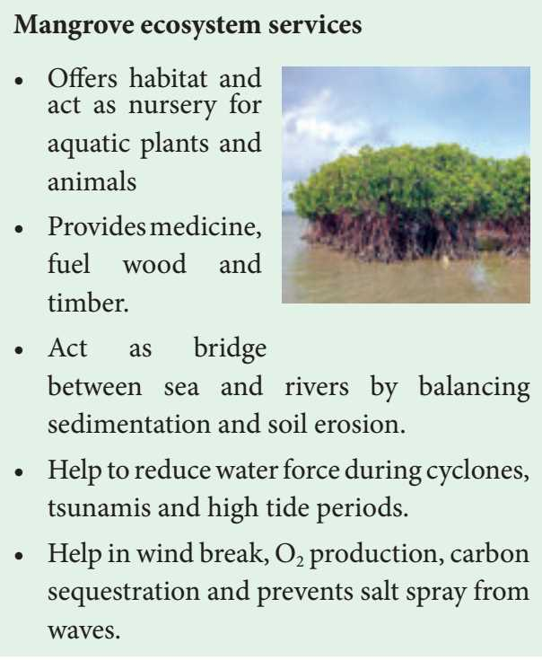
7.2.11 Ecosystem services

Slide 41
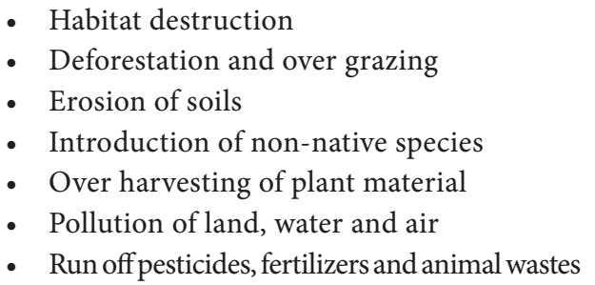
How do anthropogenic activities affect ecosystem services?

Slide 42
7.2.11 Ecosystem services

Slide 43
How to protect the ecosystem?
“If we fail to protect environment, we will fail to save posterity”
we have to practice the following in our day today life:
Buy and use only ecofriendly products and recycle them.
Grow more trees
Choose sustained farm products (vegetables, fruits, greens, etc.)
Reduce the use of natural resources.
Recycle the waste and reduce the amount of waste you produce.
Reduce consumption of water and electricity and reduce carbon footprint.
Reduce or eliminate the use of house-hold chemicals and pesticides.
Maintain your cars and vehicles properly.
Create awareness and educate about ecosystem protection among your friends and family members and ask them to find out solution to minimize this problem.

Slide 44
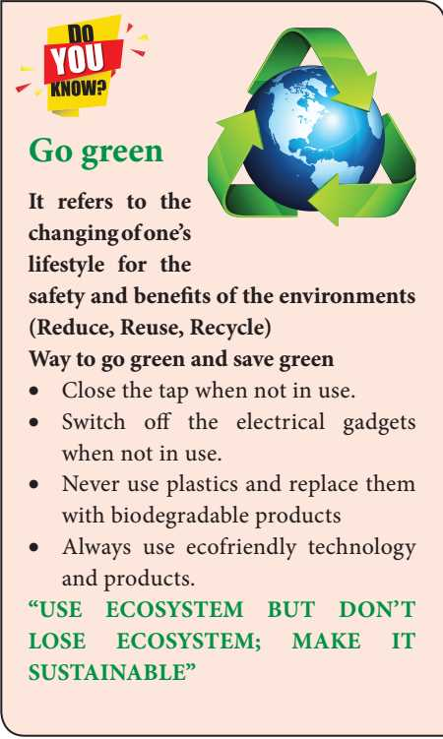
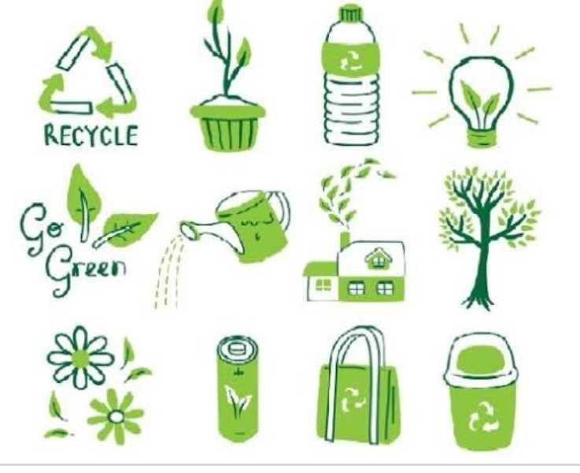
How to protect the ecosystem?

Slide 45
7.2.12 ECOSYSTEM MANAGEMENT
Strategy of ecosystem management
Maintain biodiversity of ecosystems.
Indicating the damaged ecosystem (Some species indicate the health of the ecosystem: such species are called a flagship species).
Recognize the inevitability of ecosystem change and plan accordingly.
Used for achieving sustainability of ecosystem through sustainable development programme (or projects).
Identifying ecosystems which are in need of rehabilitation.
Collaborative management with government agencies, local population, communities and NGO’s.
Build the capacity of local institutions and community groups to assume responsibility for long term implementation of ecosystem management activities even after the completion of the project..

Slide 46
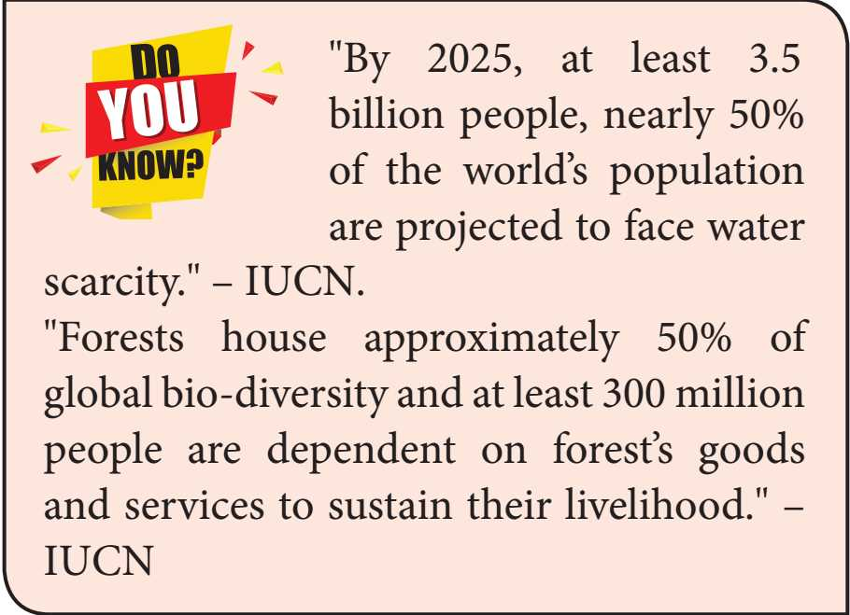
ECOSYSTEM MANAGEMENT

Slide 47
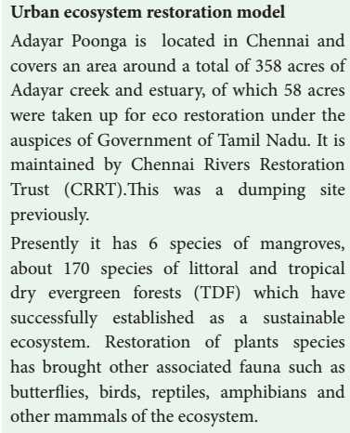
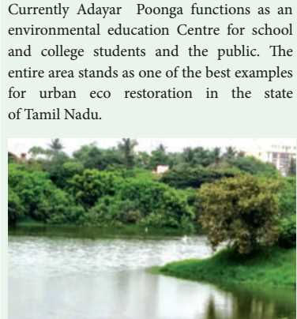
7.2.12 ECOSYSTEM MANAGEMENT

Slide 48
7.3 Plant succession
Succession - Such successive replacement of one type of plant community by the other of the same area/ place.
Pioneers- First invaded plants in a barren (nude) area .
Seral communities- A series of transitional developments of plant communities one after another in a given area.
7.3.1 Causes of Succession
a) Initiating causes – Barren area formed by the activity of biotic and abiotic factors.
b) Continuing causes - Migration , aggregation, competition and reaction.
c) Stabilizing causes- Establishment of plant communities.

Slide 49
7.3.2 Characteristics of ecological succession
Causes changes in specific structure of plant community.
Changes of abiotic and biotic factors.
Transforms unstable community into a stable community.
Gradual progression in species diversity, total biomass, niche specialisation , and humus content of soil takes place.
Progresses from simple food chain to complex food web
Modifies the lower and simple life form to the higher life forms.
Creates inter-dependence of plants and animals.

Slide 50
7.3.3 Types of succession

Slide 51
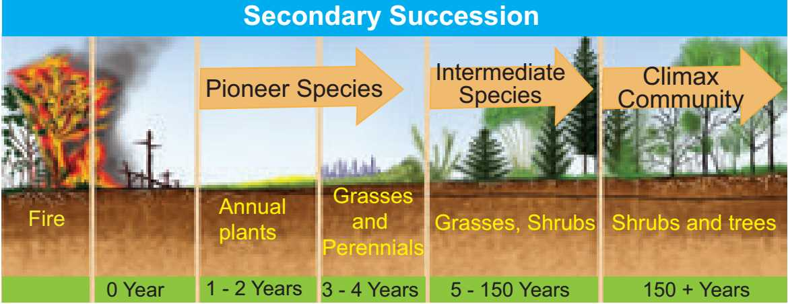
2. Secondary succession

Slide 52
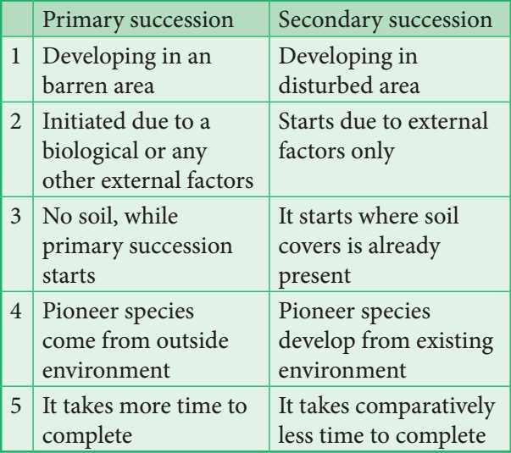
Differences between primary and secondary succession

Slide 53
7.3.4 Process of succession
(1) Nudation- Development of barren area.
(2) Invasion- Species invade barren area.
(3) Ecesis – Establishment of invaded species in a particular area.
(4) Aggregation - Successful establishment and reproduction.
(5) Competition- Inter and intra specific competition among individuals.
(6) Reaction – Gradual changes in environmental conditions by the species in an area.
(7) Stabilization (Climax)- Final establishment of plant communities.

Slide 54
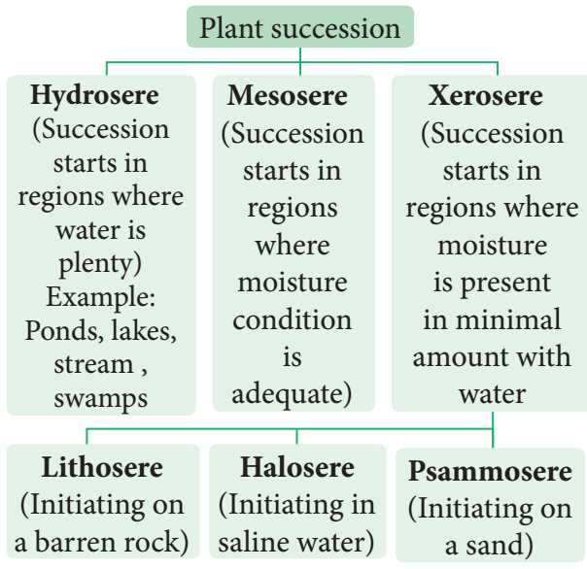
7.3.5 Classification of plant succession

Slide 55
Hydrosere
Succession in a freshwater.
Phytoplankton stage - Pioneer community blue green algae, green algae, diatoms, bacteria.
Submerged plant stage – Chara, Utricularia, Vallisneria and Hydrilla.
Submerged free floating plant stage – : Nelumbo, Nymphaea,,Azolla, Lemna, Wolffia and Pistia.
Reed-swamp stage – Typha, Phragmites, Sagittaria and Scirpus .
Marsh meadow stage – Carex, Juncus, Cyperus and Eleocharis .
.
6) Scrub stage – Shrubs (Salix and Cornus) ; Trees (Populus and Alnus).
7) Forest stage - Temperate mixed forest (Ulmus,Acer and Quercus), Tropical rain forest (Artocarpus and Cinnamomum ) and Tropical deciduous forest (Bamboo and Tectona)..
Stage 1 -Pioneer community; Stage -2- 6 Seral communities; Stage 7 -Climax community.

Slide 56
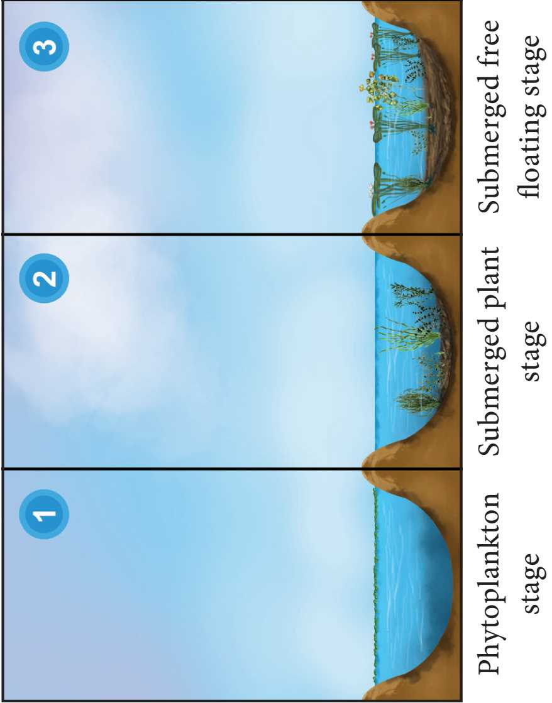
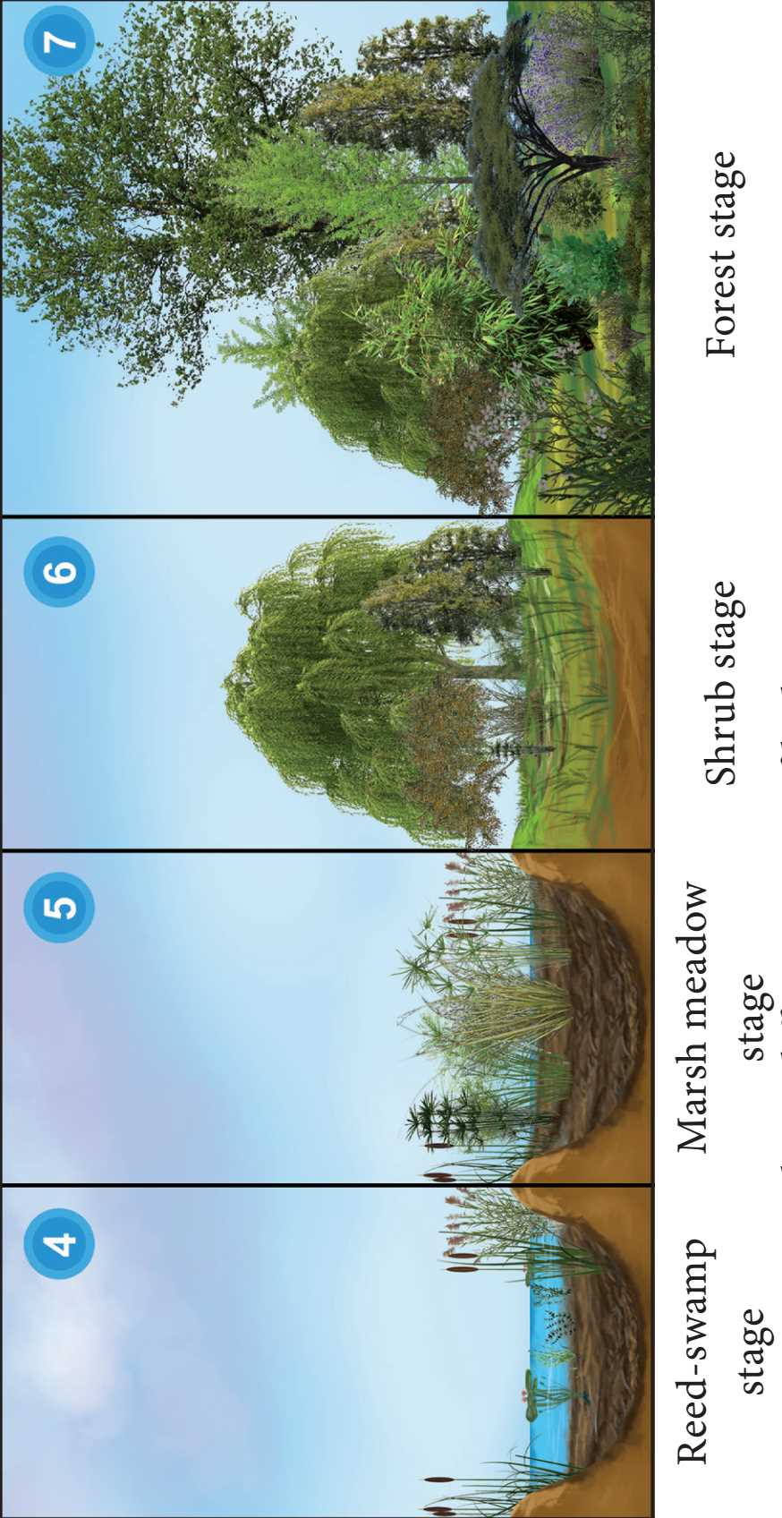
Hydrosere

Slide 57
Lithosere
Succession on barren rock.
Crustose lichen stage – Rhizocarpon and Lecanora.
Foliose lichen stage – Parmelia and Dermatocarpon.
Moss stage – Parmelia and Dermatocarpon.
Herbs stage – Arstida, Festuca and Poa.
Shrub stage –Rhus , Zizyphus and Capparis.
Forest stage - Varieties of trees.
Stage 1- Pioneer community; Stage 2- 5- Seral communities; Stage 6 -Climax community.

Slide 58
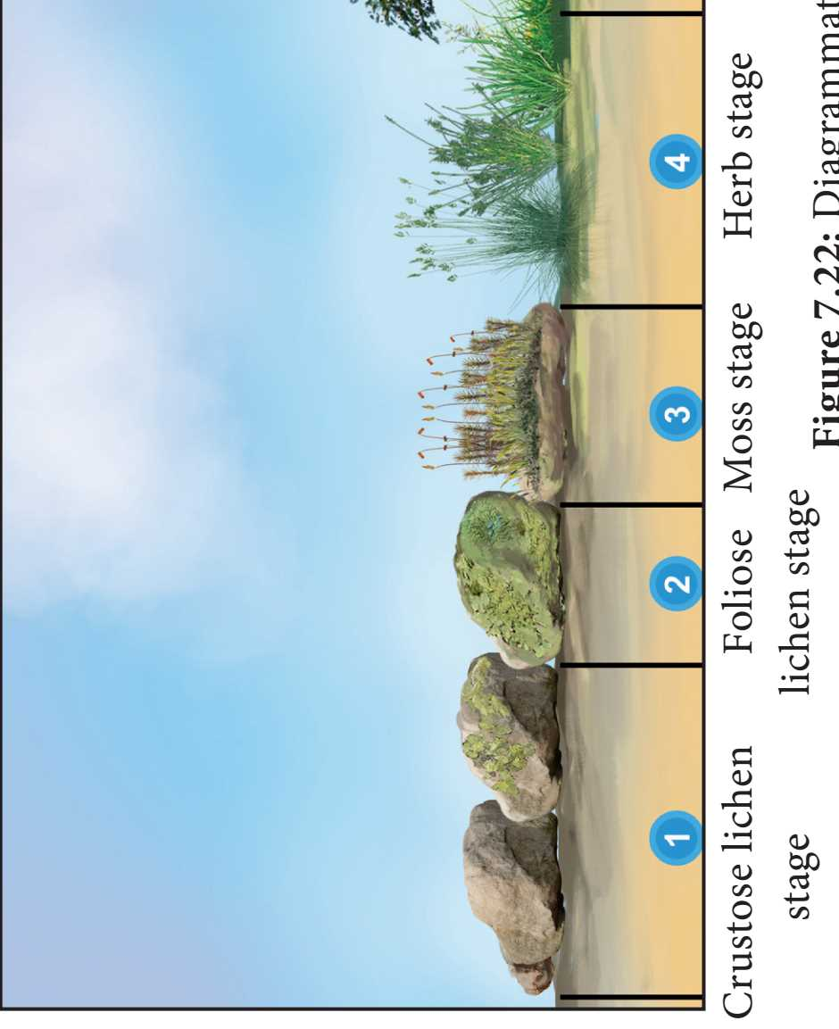
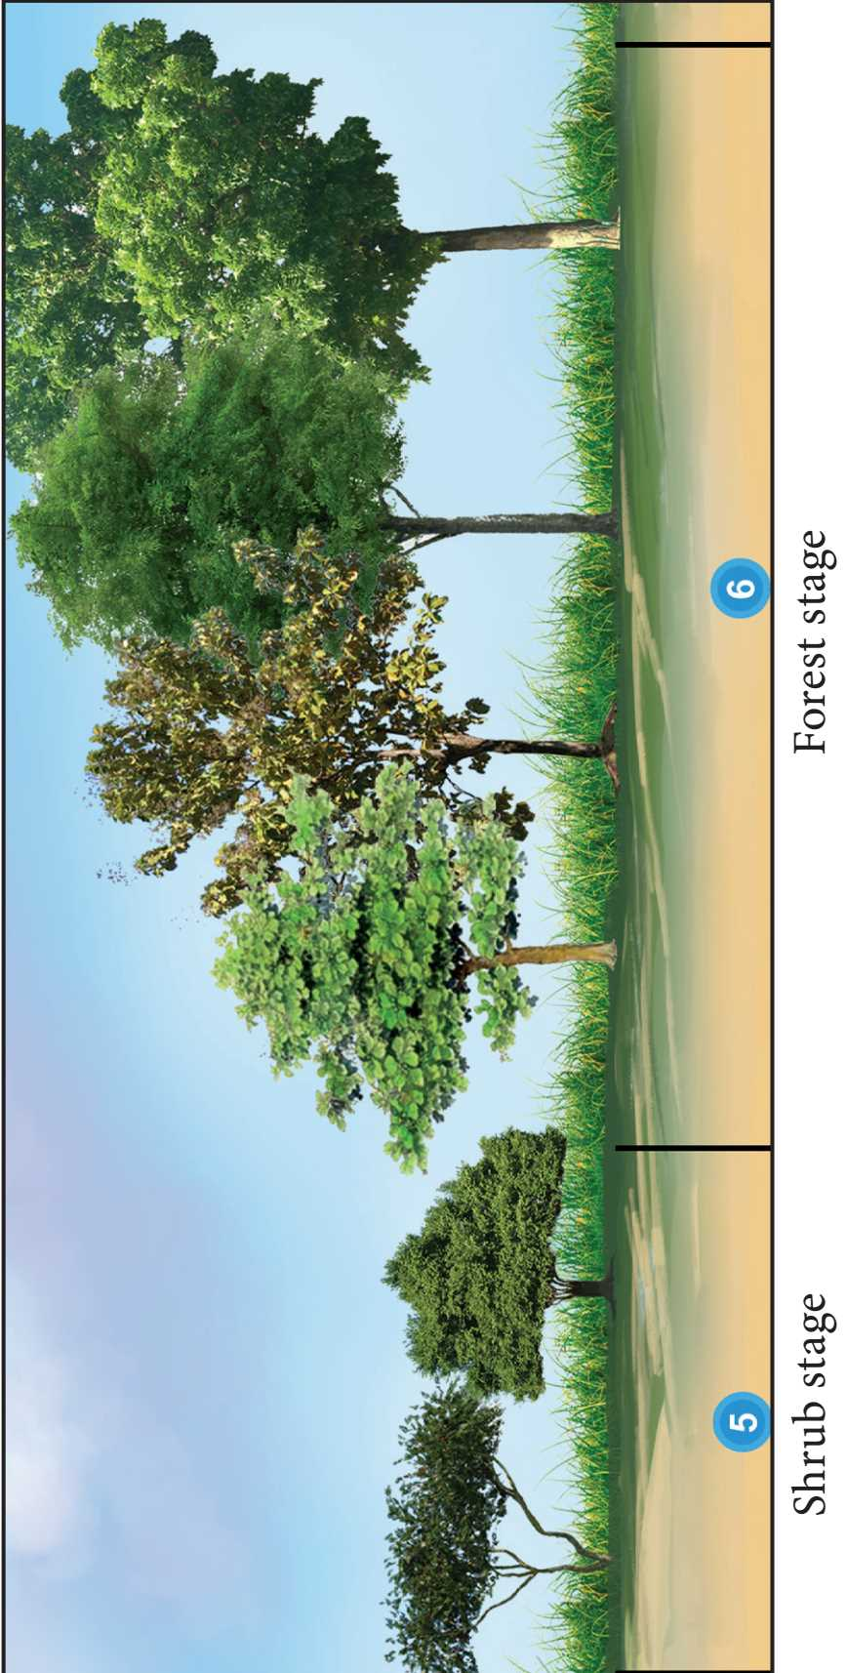
Lithosere

Slide 59
7.3.6 Significance of Plant Succession
Ecologist can access and study the seral stages of a plant community found in a particular area.
Helps to understand the controlled growth of one or more species in a forest.
Utilizing the knowledge of succession, even dams can be protected by preventing siltation.
Used during reforestation and afforestation.
It helps in the maintenance of pastures.
Maintain species diversity in an ecosystem.
Patterns of diversity during succession are influenced by resource availability and disturbance by various factors.
Involves the colonization of habitat of an area devoid of life.
Involves the reestablishment of a plant community in disturbed area or habitat.
10. Forests and vegetation that we come across all over the world are the result of plant succession.

Slide 60
7.4 Vegetation
Plant cover of an area.
7.4.1 VEGETATION TYPES OF INDIA AND TAMIL NADU
Forest vegetation
2. Grassland vegetation
3. Riparian vegetation
4. Aquatic and semi aquatic vegetation

Slide 61
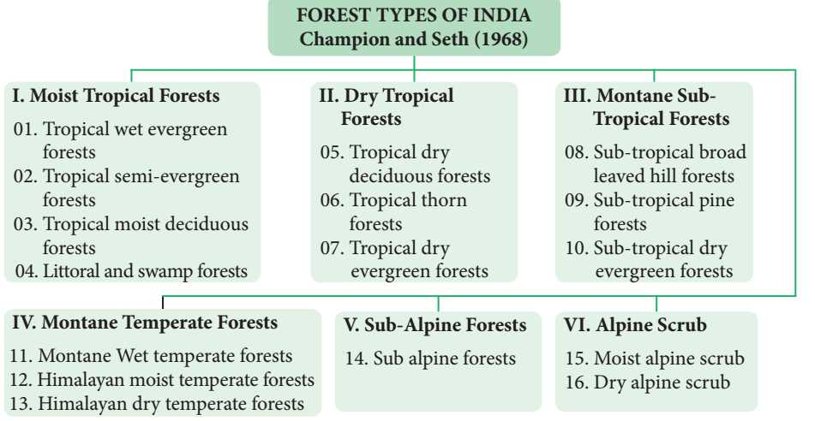
FOREST TYPES OF INDIA

Slide 62
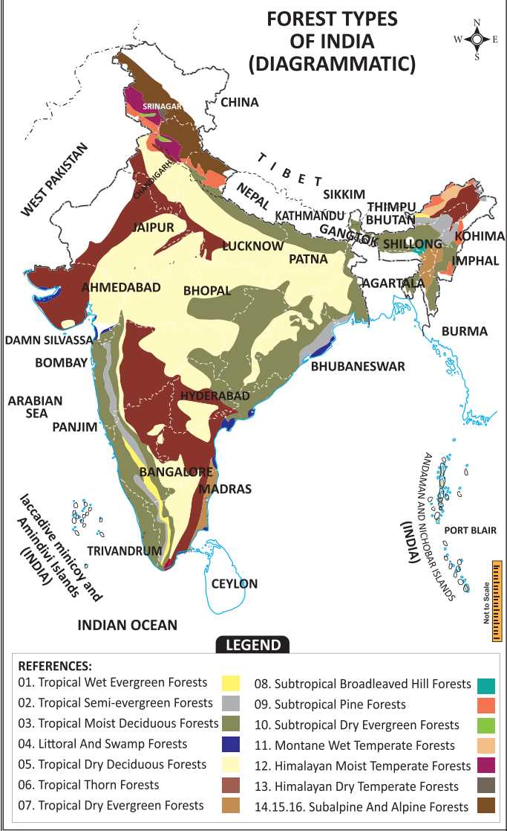
MAP SHOWING FOREST TYPES OF INDIA
( CHAMPION AND SETH -1968 )

Slide 63
FOREST TYPES OF TAMIL NADU

Slide 64
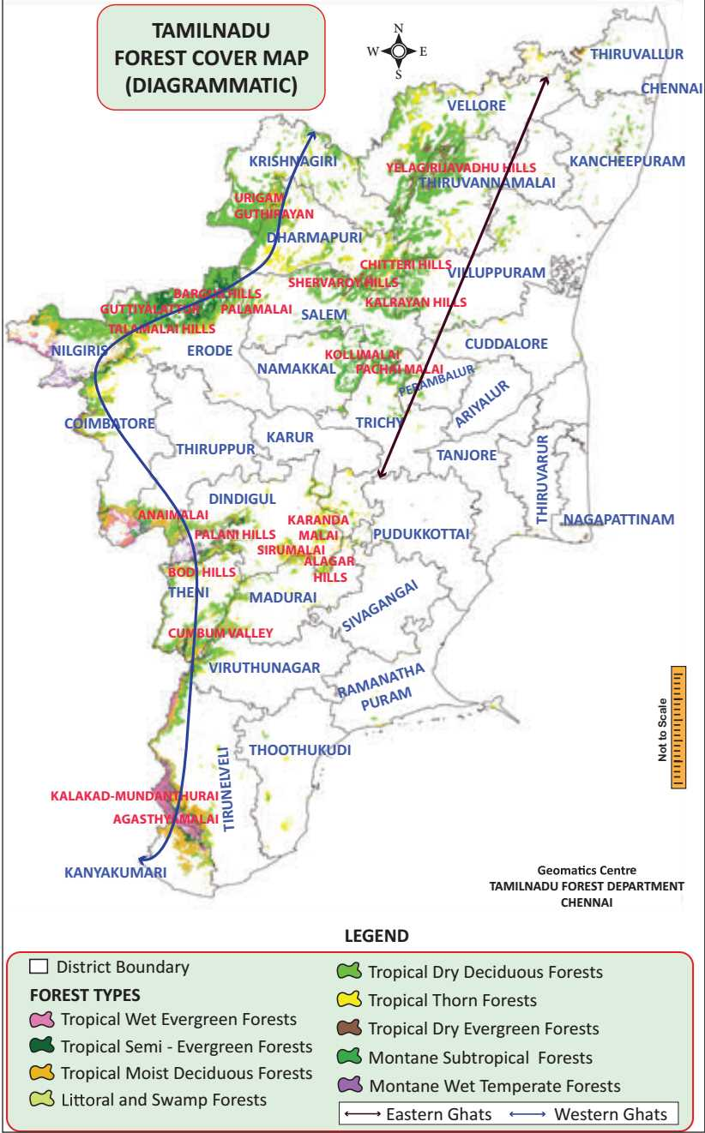
MAP SHOWING FOREST TYPES OF TAMIL NADU

Slide 65
7.4 Vegetation
2. GRASS LAND VEGETATION
Vegetation community predominated by graminoids (i.e. grass and grass like plants).
a) Low altitude grasslands
Altitude upto 1000 m. Halopyrum, Wild Saccharum, Arundinella, Heteropogon, and Chrysopogon. Deccan plateau, Chota Nagpur plateau, Gangetic, Brahmaputra valley and Eastern Ghats.
b) Higher altitude grassland
Altitude above 1000 m. Chrysopogon, Arundinella, Andropogon, Heteropogon, Cymbopogon, Imperata, Festuca, and Agrostis.. Southern slopes of Himalayas, sub-Himalayan ranges, Nagaland, Himachal Pradesh and Western ghats.

Slide 66
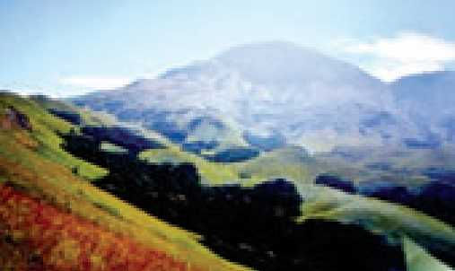
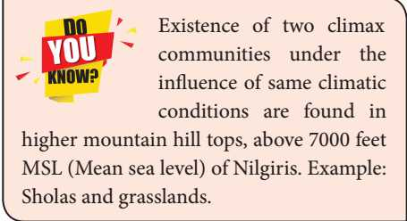
Higher altitude grassland

Slide 67
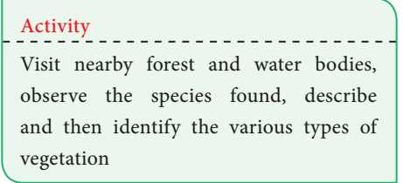
7.4 Vegetation
RIPARIAN VEGETATION
Vegetation is located along streams and rivers.
Terminalia, Diospyros,Salix,Ficus and grasses.
Banks of Godavari, Krishna, Ganga, Brahmaputria, Narmadha Yamuna and riverbeds of Cauvery and Thamirabharani

Slide 68
7.4 Vegetation
4) AQUATIC AND SEMI-AQUATIC VEGETATION
Vegetation is found in lakes, ponds, puddles and marshy places.
Nelumbo, Nymphaea, Bacopa,Typha,Pandanus,Cyperus,Aeschynomene,Hydrilla, Aponogeton and Potomogeton.
Found in all inland parts of India and Tamil Nadu.

Slide 69
CHAPTER. 7. ECOSYSTEM
SUMMARY
EVALUATION
GLOSSARY

